Slide 1
Game Design
4. Animation and Level creation
Unity Workshop - WS 19-20

Slide 2
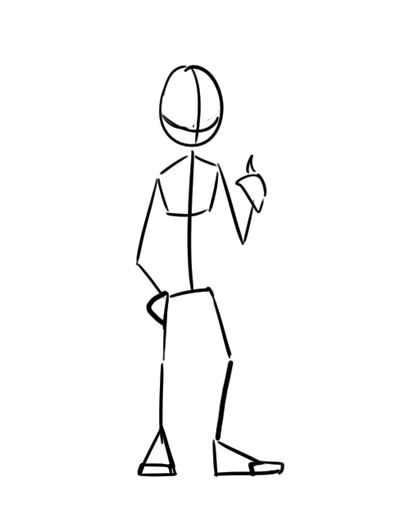
Animation
In Unity:
- StateMachine
- Imported from external sources (Maya,
Blender…), or
- simple Animations can be created in Unity
(e.g. Transformations)
Animation makes a character alive and gives additional feedback to the user‘s input.

Slide 3
Animation – Create Animation
Animation Window
Current property which is animated
Current animation for this object (can be more than one)
Keyframe to set specific values for this time
Timeline how the property changes over an amount of time
Add a new property to animat (e.g. position or rotation)

Slide 4
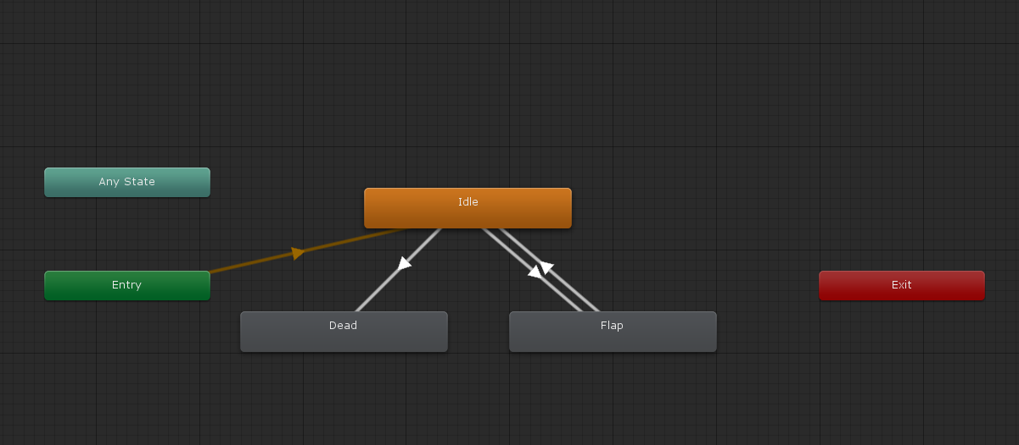


Animation - Animator
Idle
Update loop
Input
Death
Condition
Animation State Machine for Player

Slide 5
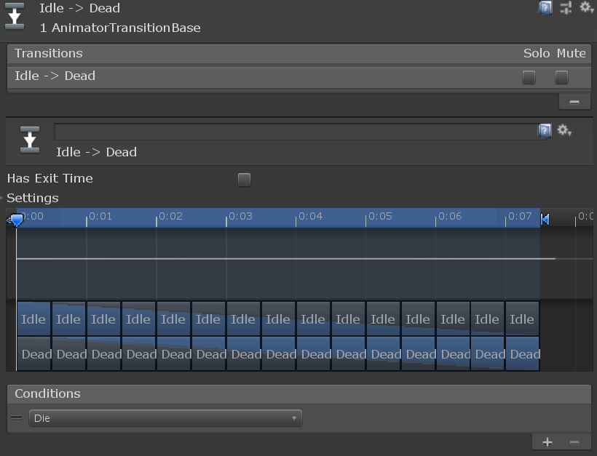
Animation - Conditions
To change animation states, we have to tell the animator, which condition (input, death) is met and to what animation it should change then:
→ Parameters (Trigger, Bool…) set in state transitions
Idle
Update loop
„Flap“ Trigger
„Die“ Trigger
Transition from Idle->Dead, when „Die“ Trigger is set
If(conditionIsMet) animator.SetTrigger(„Name“) → get animator like the rigidbody in script

Slide 6
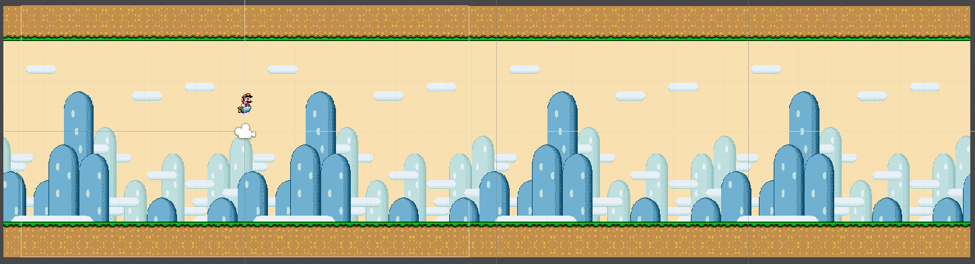
Level Creation – Background Repetition
Camera View
Multiple seamless backgrounds:
Move them to the left and reposition them at the right, when they are not visible in the camera‘s view
2 Scripts: One for Scrolling and one for the repetition:
ScrollingObject: move ist Rigidbody2D to the left, as long as game is not over with a certain speed
RepeatingBackground: check if ist position surpassed ist width (get width by collider size) and reposition it to the right

Slide 7

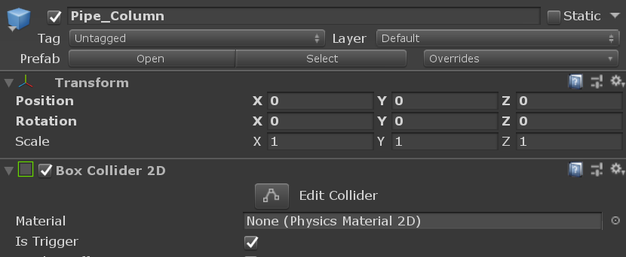
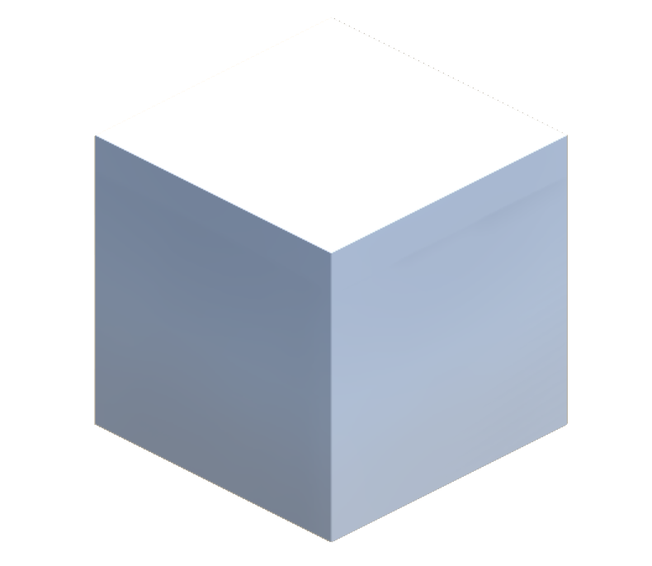
Level Creation – Prefabs
Prefab
Object 1
Object 2
Object 3
Object 4

Slide 8
Level Creation – Prefabs
public GameObject Prefab;
Prefab
public static Object Instantiate(Object original, Transform parent);
var o = Instantiate(Prefab, this.transform) as GameObject;

Slide 9
Level Creation Spawn Rate – Timed Execution
Update and DeltaTime
float timeElapsed = 0f;
void Update()
{
timeElapsed += Time.deltaTime;
if(time >= rate) DoSomething();
}
2. Coroutines
→ StartCoroutine(WaitAndPrint());
IEnumarator WaitAndPrint()
{
yield return new WaitForSeconds(5);
print(“WaitAndPrint“ + Time.time;
}

Slide 10
Level Creation – Object Pool
Continous deleting and instantiating of objects during runtime are costly
Reduce these actions to as less as possible
Reuse instantiated objects
Solution: Object Pooling
Idea:
Create several instances at intialization
Deactivate all of them and store them in a „pool“ (Array or List)
If a new object is needed, get it from the pool and activate it
If not needed anymore, deactivate it again and put it back in the pool
Only if pool is empty and a new object is needed, instantiate a new object

Slide 11
Level Creation – Object Pool
GameObject[] objectPool
void Start()
{
for(i=0;i<num;i++) {
var obj = Instantiate(prefab);
obj.SetActive(false);
objectPool[i] = obj;
}
}
void ActivateNextObject()
{
var obj = objectPool[nextPossibleObjectIndex];
obj.SetActive(false);
//remove and readding possible, readd when not needed anymore
}

Slide 12
Put everything together
Create an obstacle prefab
Create a script for object handling
Instantiate some prefabs at initialization and store them in a pool
Define a spawn rate and activate an obstacle from the pool at the rate
Give the obstacle a random y-position (in a defined range)
Move the obstacle to the left
Reuse instantiated obstacle

